Slide 1
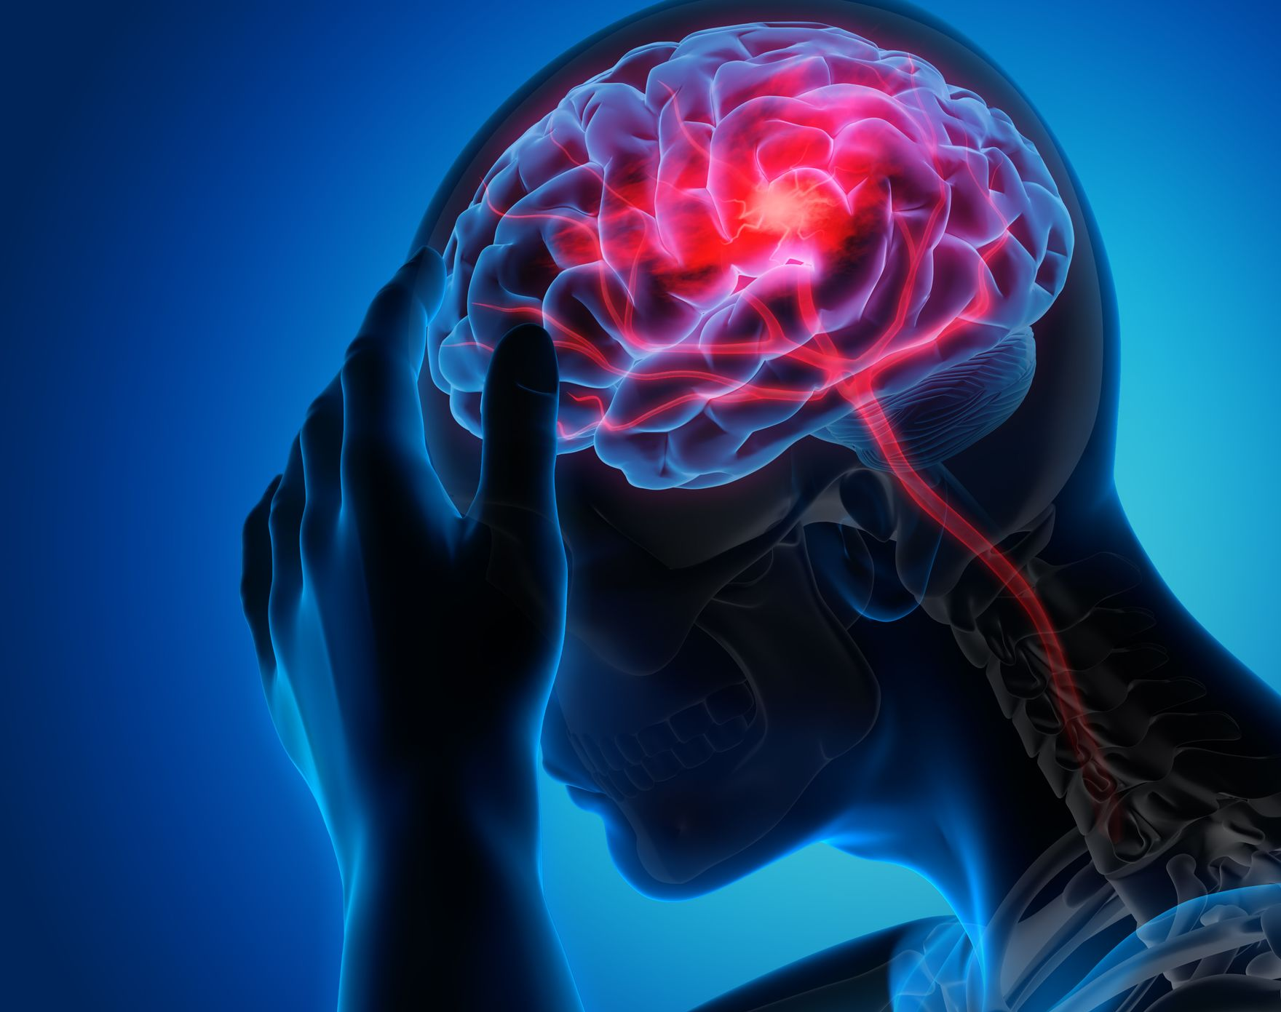
Machine Learning Stroke Severity Analysis
Contributors: Austin Calvo, Sierra Quevedo, Paul Schnase & Paul Serna

Slide 2
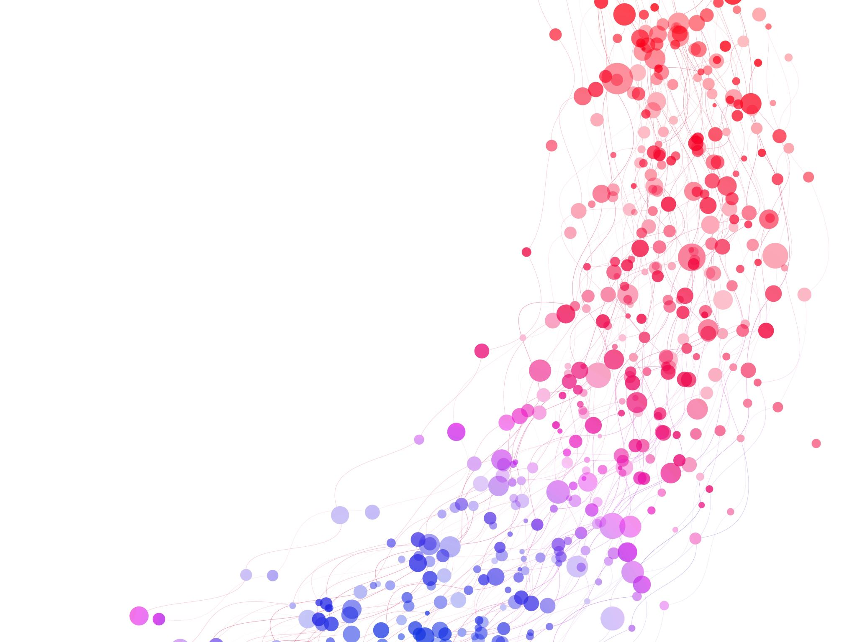
Outline
Introduction
Objective
Tools
Datasets and Inputs
Visualizations
Outcome/Results
Prediction APP

Slide 3

Introduction
n, according to CDC, Stroke is the 5th leading According to the CDC, in 2020, 1 in 6 deaths resulted from cardiovascular disease due to stroke. In addition, according to CDC, Stroke is the 5th leading cause of death in the US. This dataset predicts stroke severity for patients who have suffered a stroke by examining the input parameters like age, gender, systolic, diastolic, severity level, glucose, paralysis, smoking, BMI, and cholesterol. The dataset provides relevant details about each individual.
.

Slide 4

Objective
Many stroke risk indicators are manageable, making the prognosis for stroke victims hopeful for reducing the likelihood of suffering by taking the needed actions and receiving treatment earlier. This project explores the problem of predicting stroke risk indicators severity in an individual by examining possible stroke indicators through data & analytics, and machine learning. We intend to assist medical providers in providing a prognosis for the level of recovery a patient can expect. This project uses machine learning to create a model capable of predicting Stroke results based on a dataset containing individual data points.

Slide 5

Tools Used for the Analysis SQL Flask App Tableau Juypter Notebook

Slide 6
Classification Models Used: Machine learning modeling to predict stroke severity risk indicators in patients using the Random Forest classification algorithm. This algorithm works based on existing features and similarities between these features to classify targets.

Slide 7
Inputs in Datasets Gender Severity level Systolic & Diastolic Glucose Paralysis Smoking BMI Cholesterol

Slide 8
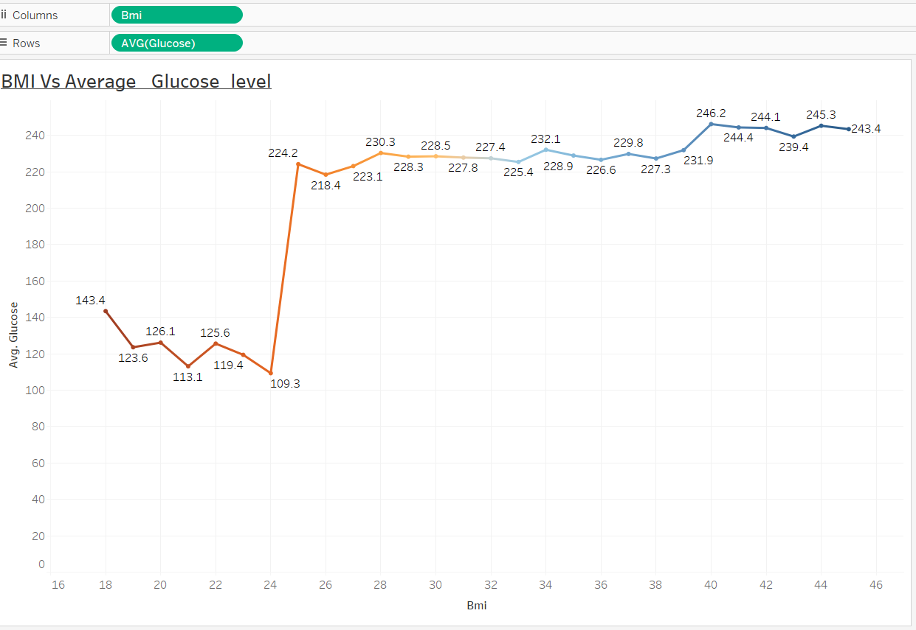
Visualizations

Slide 9
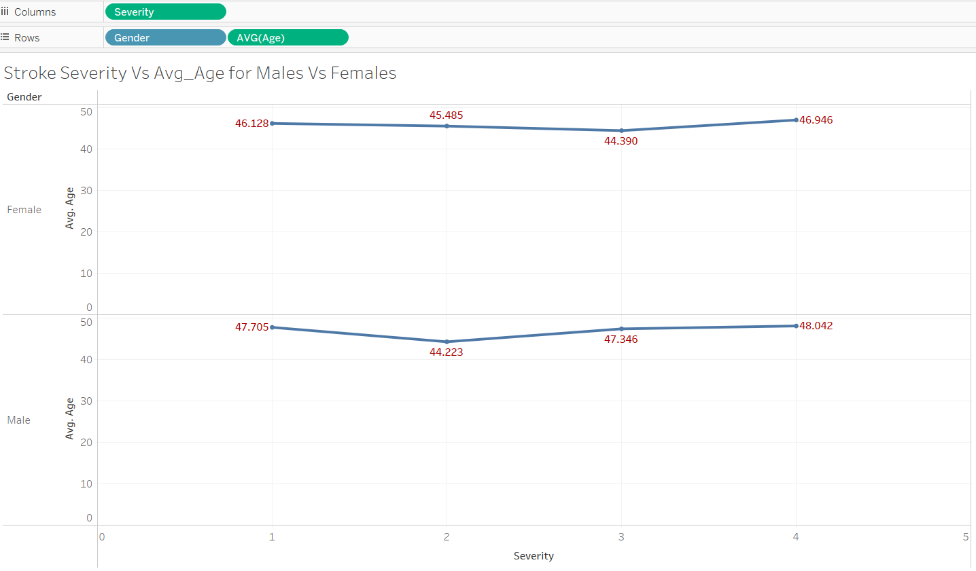
Visualizations

Slide 10
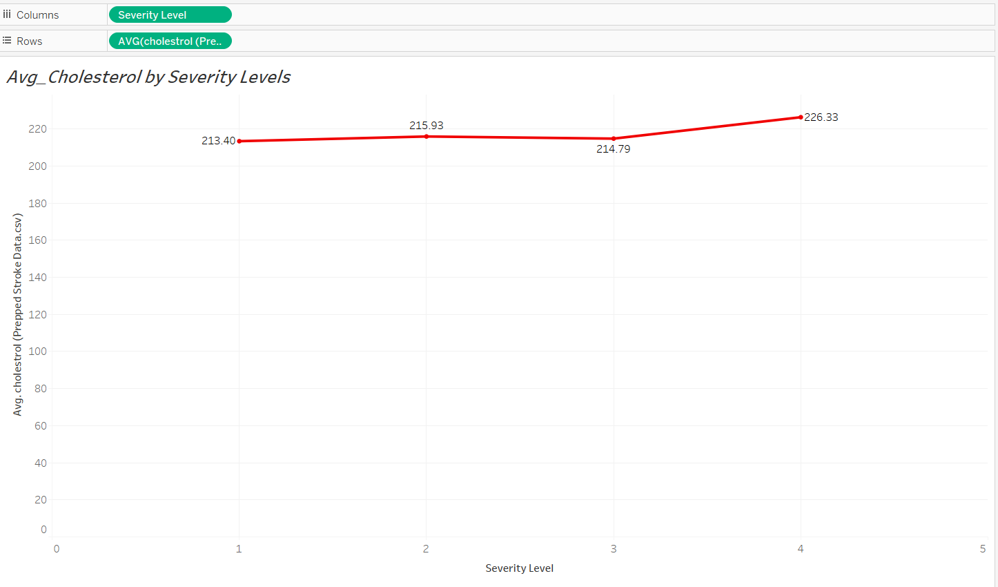
Visualizations

Slide 11
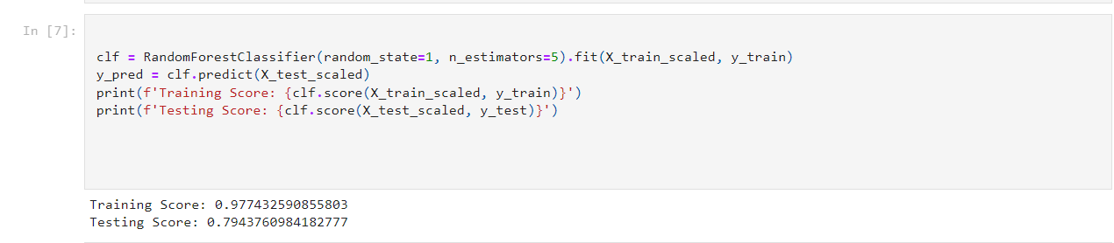
Results:

Slide 12
APP Review:

